Slide 1
Deep Learning (CS324)
10. Adversarial Examples
Prof. Jianguo Zhang
SUSTech
*Based on http://www.deeplearningbook.org chapter 7.1.3 + and Lana et al

Slide 2
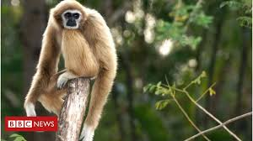
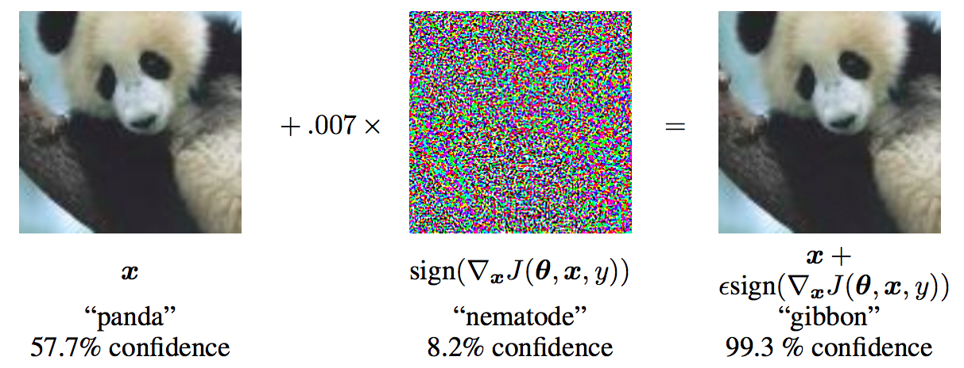
Fooling neural networks
gibbon

Slide 3
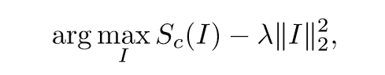
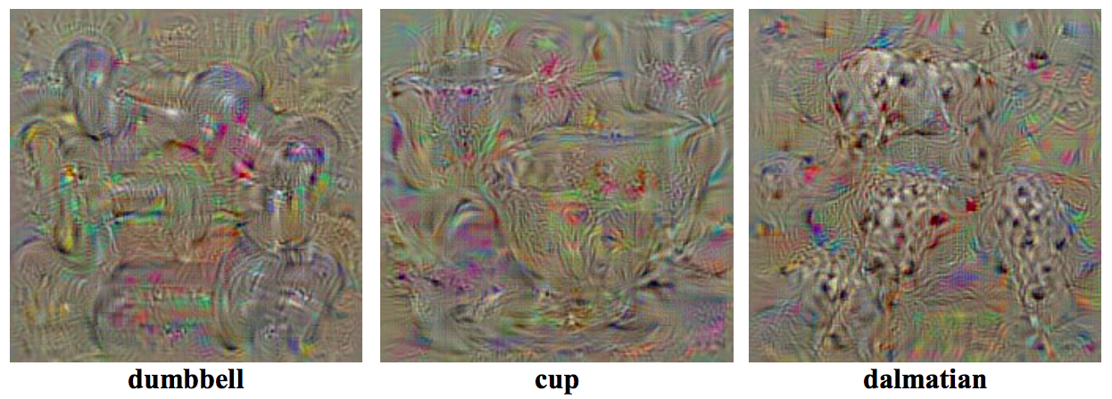
Generating preferred inputs
We can use gradient ascent to generate weird-looking images to maximize activation of a given unit
K. Simonyan, A. Vedaldi, and A. Zisserman, Deep Inside Convolutional Networks: Visualising Image Classification Models and Saliency Maps, ICLR 2014

Slide 4
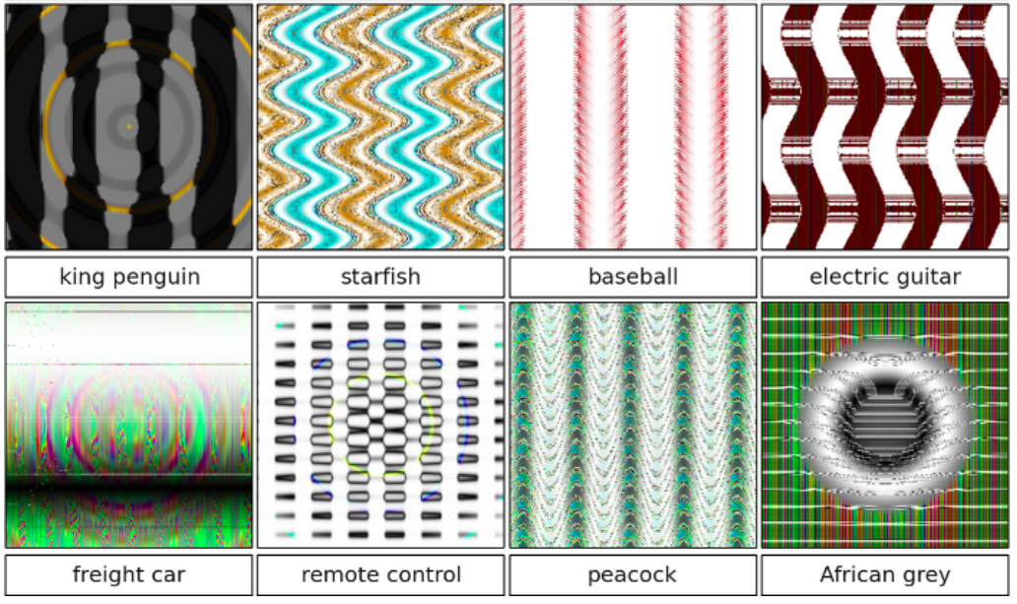
Generating preferred inputs
Related finding: it is easy to generate perceptually meaningless images that will be classified as any given class with high confidence
A. Nguyen, J. Yosinski, J. Clune, Deep Neural Networks are Easily Fooled: High Confidence Predictions for Unrecognizable Images, CVPR 2015

Slide 5
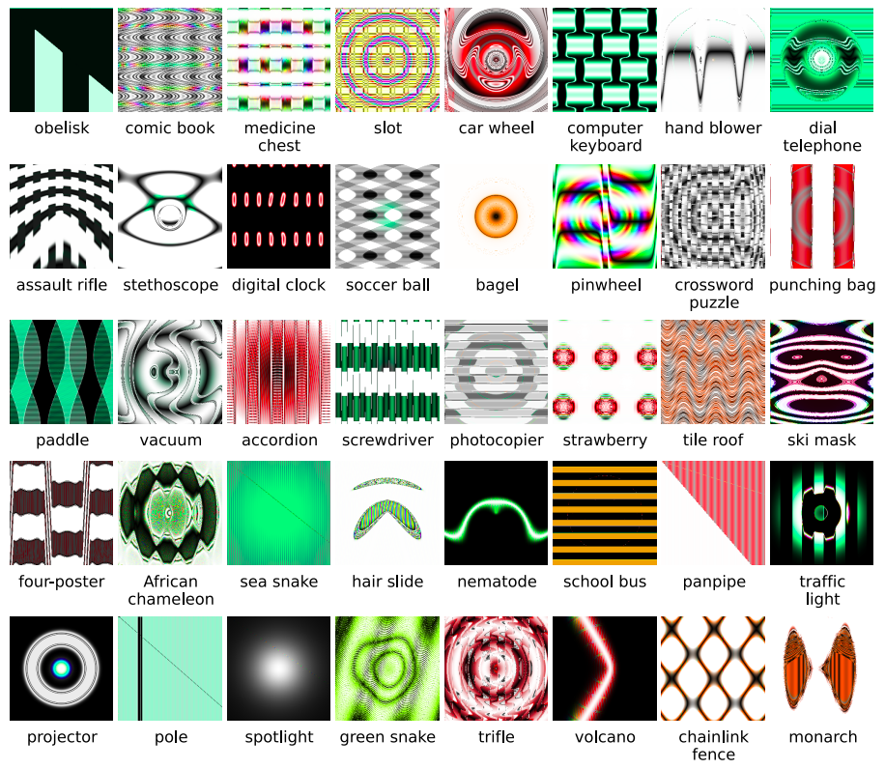
Generating preferred inputs
A. Nguyen, J. Yosinski, J. Clune, Deep Neural Networks are Easily Fooled: High Confidence Predictions for Unrecognizable Images, CVPR 2015

Slide 6
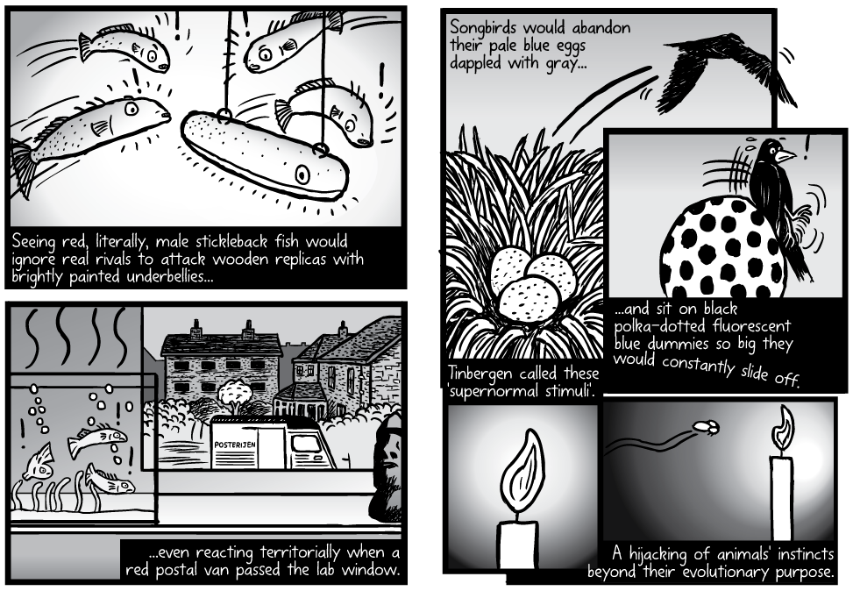
Biological phenomenon: Supernormal stimuli
http://www.stuartmcmillen.com/comic/supernormal-stimuli/
https://en.wikipedia.org/wiki/Supernormal_stimulus

Slide 7
Supernormal stimuli for humans?

Slide 8
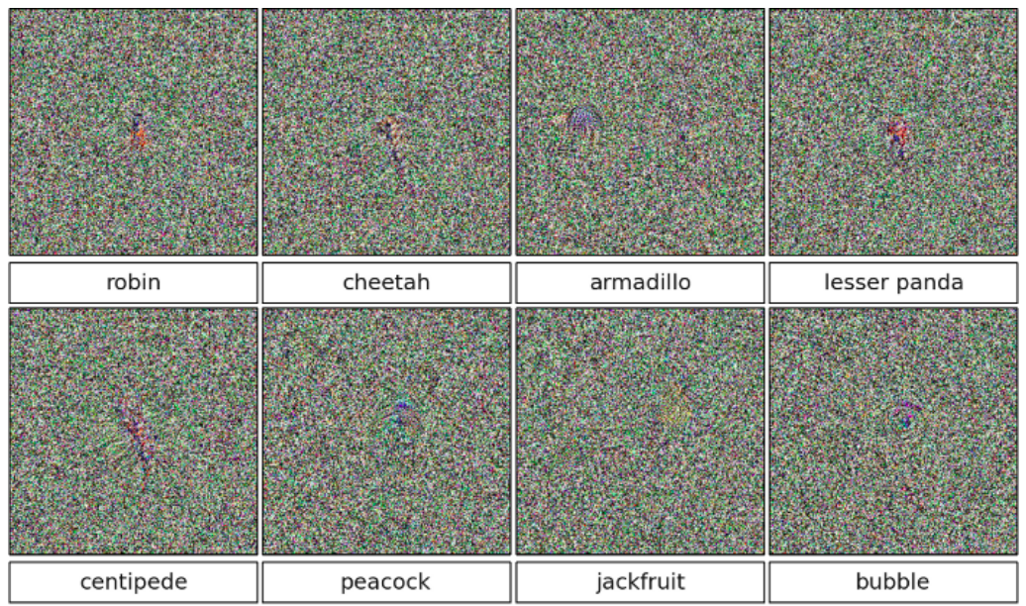
Generating preferred inputs
It is easy to generate perceptually meaningless images that will be classified as any given class with high confidence
A. Nguyen, J. Yosinski, J. Clune, Deep Neural Networks are Easily Fooled: High Confidence Predictions for Unrecognizable Images, CVPR 2015

Slide 9
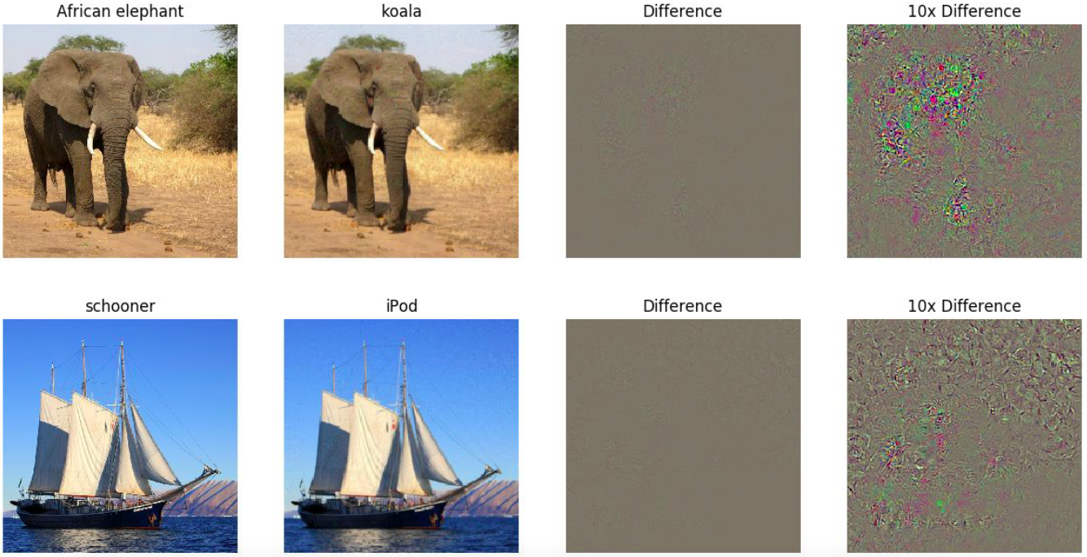
Adversarial examples
We can “fool” a neural network by imperceptibly perturbing an input image so it is misclassified
Source: Stanford CS231n

Slide 10
Outline
How to fool neural networks?
Properties of adversarial examples
Why are neural networks easy to fool?
How to defend against being fooled?
Fooling detectors

Slide 11
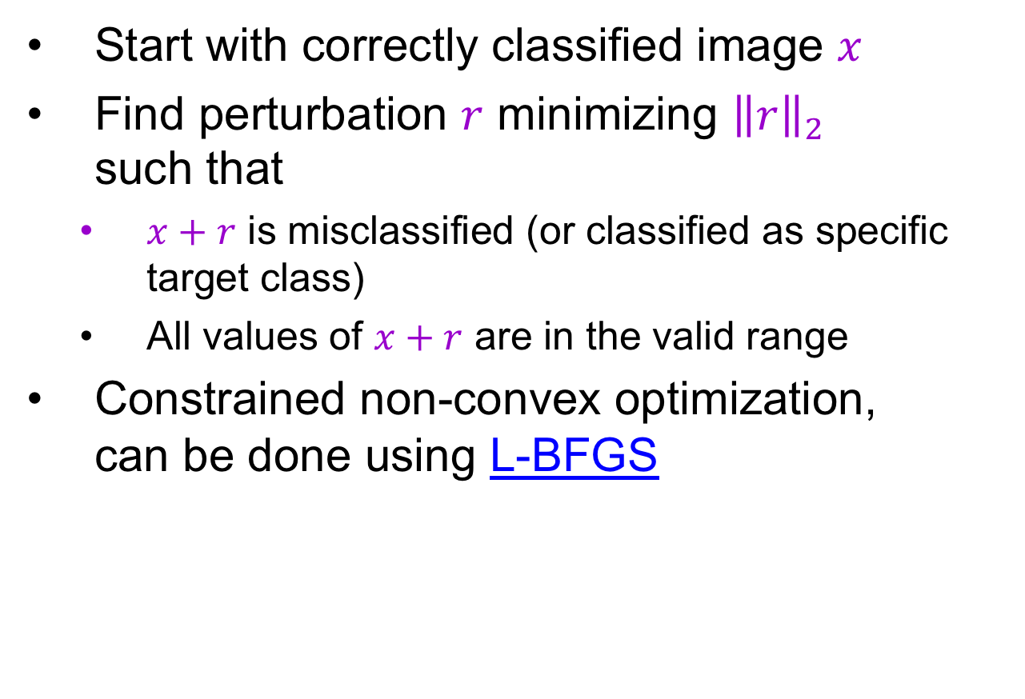
Finding the smallest adversarial perturbation
Start with correctly classified image $x$
Find perturbation $r$ minimizing ${\left\|r\right\|}_{2}$ such that
$x+r$ is misclassified (or classified as specific target class)
All values of $x+r$ are in the valid range
Constrained non-convex optimization, can be done using L-BFGS
C. Szegedy, W. Zaremba, I. Sutskever, J. Bruna, D. Erhan, I. Goodfellow, R. Fergus, Intriguing properties of neural networks, ICLR 2014
Notes:
Let us see how we can find perturbation

Slide 12
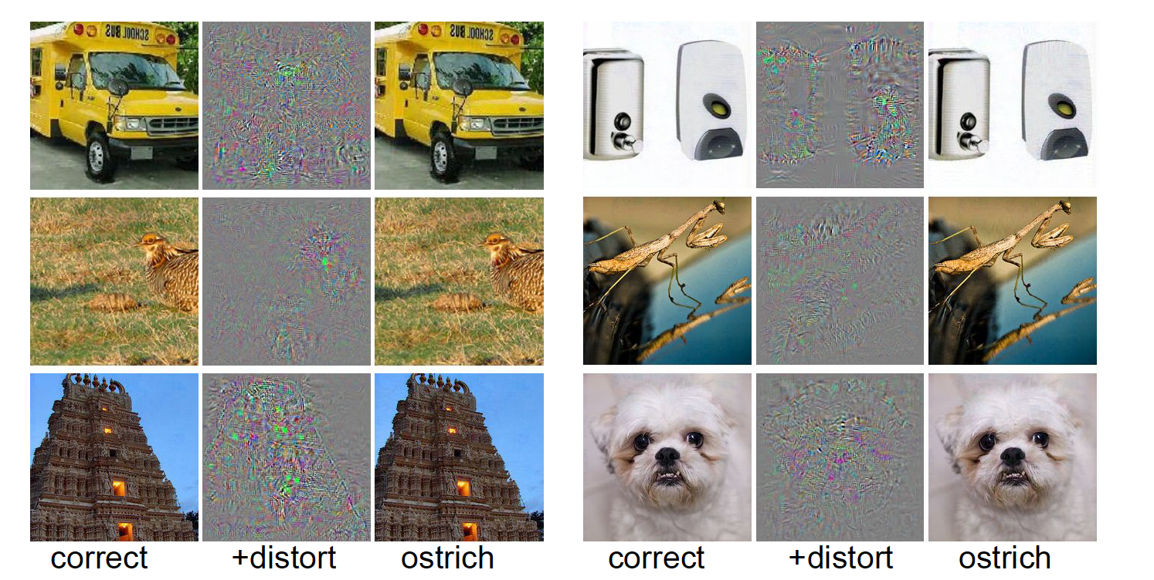
Finding the smallest adversarial perturbation
Sample results:
Input
Perturbation
x 10
“Ostrich”
Input
Perturbation
x 10
“Ostrich”
C. Szegedy, W. Zaremba, I. Sutskever, J. Bruna, D. Erhan, I. Goodfellow, R. Fergus, Intriguing properties of neural networks, ICLR 2014

Slide 13
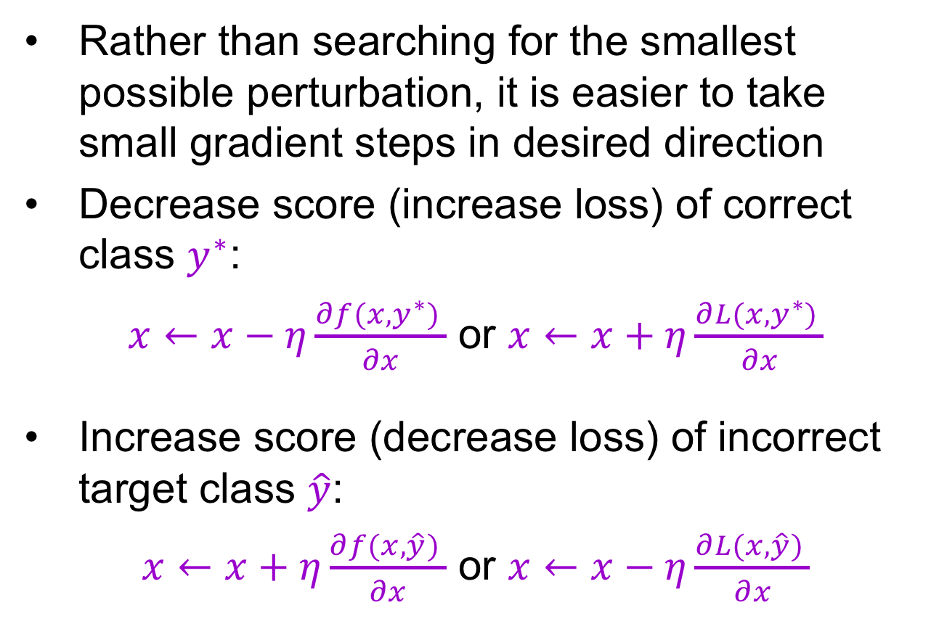
Gradient ascent
Rather than searching for the smallest possible perturbation, it is easier to take small gradient steps in desired direction
Decrease score (increase loss) of correct class $y^{∗}$:
$x←x−η⁡\frac{∂f(x,y^{∗}) }{∂x}$ or $x←x+η⁡\frac{∂L(x,y^{∗}) }{∂x}$
Increase score (decrease loss) of incorrect target class $\hat{y}$:
$x←x+η⁡\frac{∂f(x,\hat{y}) }{∂x}$ or $x←x−η⁡\frac{∂L(x,\hat{y}) }{∂x}$

Slide 14
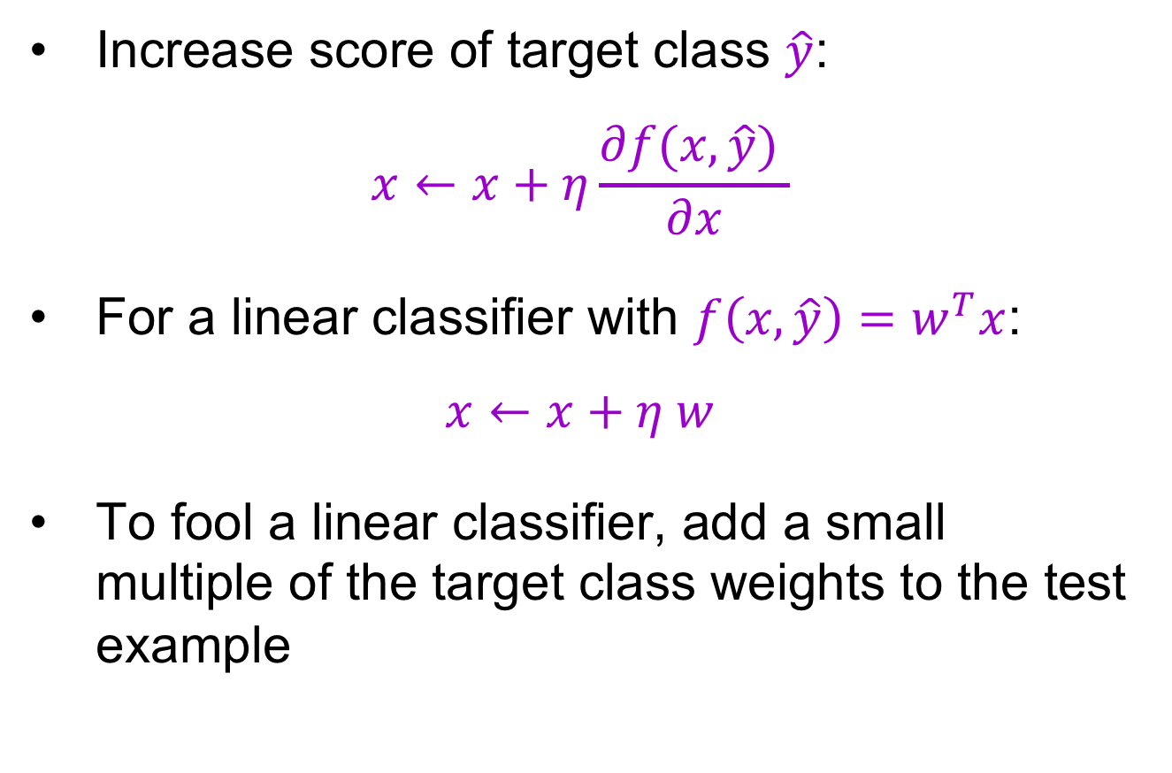
Fooling a linear classifier
Increase score of target class $\hat{y}$:
$$x←x+η⁡\frac{∂f(x,\hat{y}) }{∂x}$$
For a linear classifier with $f\left(x,\hat{y}\right)=w^{T}x$:
$$x←x+η w$$
To fool a linear classifier, add a small multiple of the target class weights to the test example

Slide 15
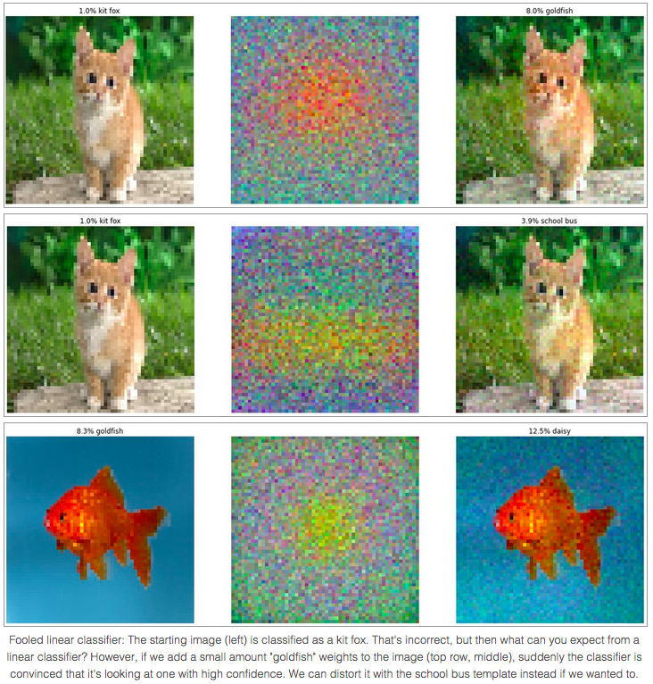
Fooling a linear classifier
http://karpathy.github.io/2015/03/30/breaking-convnets/

Slide 16
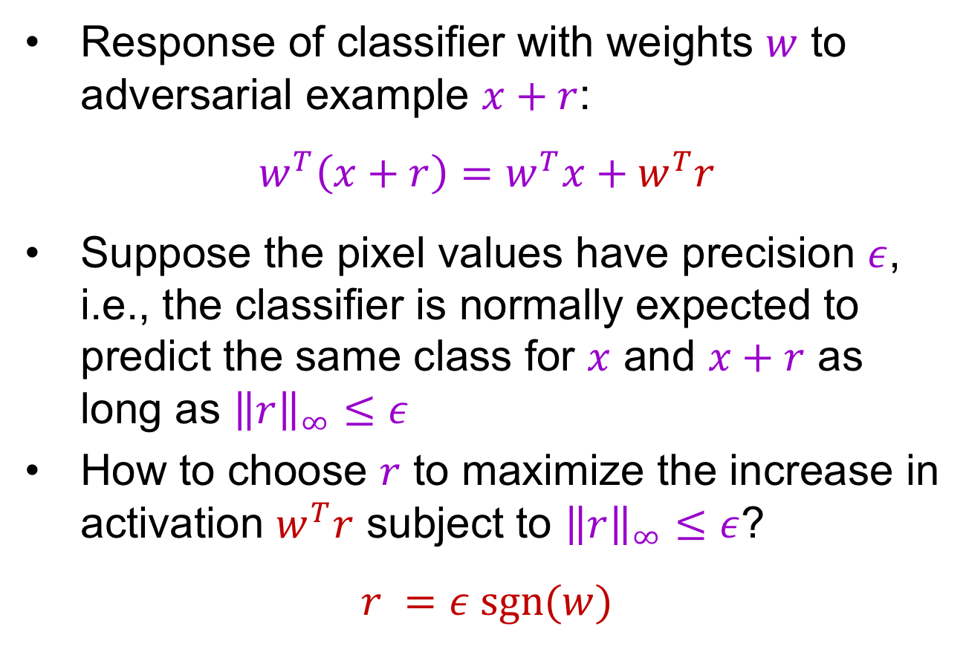
Analysis of the linear case
Response of classifier with weights $w$ to adversarial example $x+r$:
$$w^{T}\left(x+r\right)=w^{T}x+w^{T}r$$
Suppose the pixel values have precision $ε$, i.e., the classifier is normally expected to predict the same class for $x$ and $x+r$ as long as ${\left\|r\right\|}_{∞}≤ε$
How to choose $r$ to maximize the increase in activation $w^{T}r$ subject to ${\left\|r\right\|}_{∞}≤ε$?
$$r =ε sgn⁡(w)$$
I. Goodfellow, J. Schlens, C. Szegedy, Explaining and harnessing adversarial examples, ICLR 2015

Slide 17
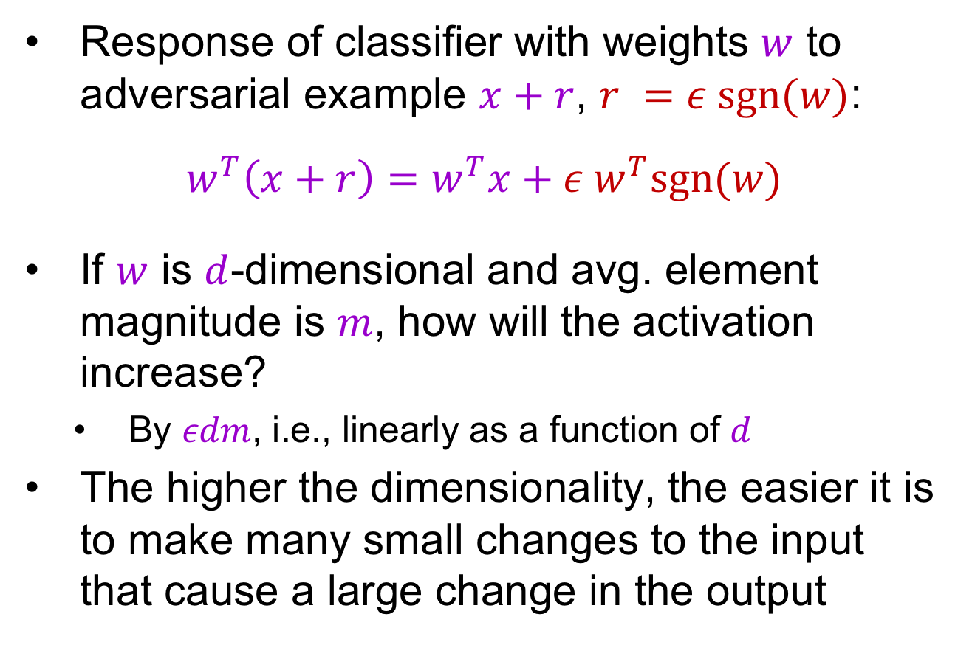
Analysis of the linear case
Response of classifier with weights $w$ to adversarial example $x+r$, $r =ε sgn⁡(w)$:
$$w^{T}\left(x+r\right)=w^{T}x+ε w^{T}sgn⁡(w)$$
If $w$ is $d$-dimensional and avg. element magnitude is $m$, how will the activation increase?
By $εdm$, i.e., linearly as a function of $d$
The higher the dimensionality, the easier it is to make many small changes to the input that cause a large change in the output
I. Goodfellow, J. Schlens, C. Szegedy, Explaining and harnessing adversarial examples, ICLR 2015

Slide 18


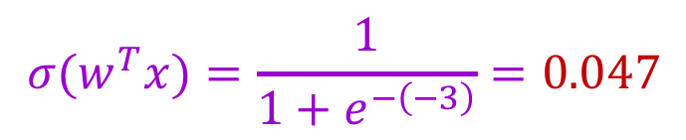
Toy example
$$x$$
2 | -1 | 3 | -2 | 2 | 2 | 1 | -4 | 5 | 1
-1 | -1 | 1 | -1 | 1 | -1 | 1 | 1 | -1 | 1
$$w$$
$$w^{T}x=−2+1+3+2+2−2+1−4−5+1=−3$$
$${σ(w}^{T}x)=\frac{1}{1+e^{−\left(−3\right)}}=0.047$$
http://karpathy.github.io/2015/03/30/breaking-convnets/

Slide 19
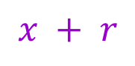
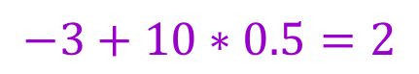
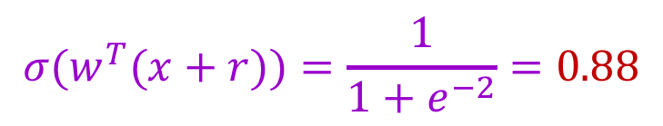

Toy example
$$x$$
2 | -1 | 3 | -2 | 2 | 2 | 1 | -4 | 5 | 1
-1 | -1 | 1 | -1 | 1 | -1 | 1 | 1 | -1 | 1
1.5 | -1.5 | 3.5 | -2.5 | 2.5 | 1.5 | 1.5 | -3.5 | 4.5 | 1.5
$$w$$
$$x + r$$
$$w^{T}x=−2+1+3+2+2−2+1−4−5+1=−3$$
$${σ(w}^{T}x)=\frac{1}{1+e^{−\left(−3\right)}}=0.047$$
$$w^{T}\left(x+r\right)=$$
$$−3+10∗0.5=2$$
$${σ(w}^{T}(x+r))=\frac{1}{1+e^{−2}}=0.88$$
http://karpathy.github.io/2015/03/30/breaking-convnets/

Slide 20
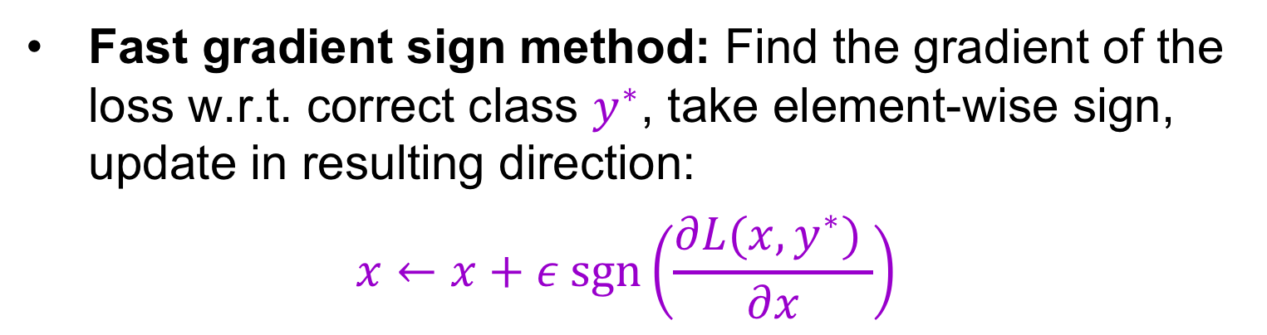
Generating adversarial examples
Fast gradient sign method: Find the gradient of the loss w.r.t. correct class $y^{∗}$, take element-wise sign, update in resulting direction:
$$x←x+ε sgn⁡\left(\frac{∂L(x,y^{∗}) }{∂x}\right)$$
I. Goodfellow, J. Schlens, C. Szegedy, Explaining and harnessing adversarial examples, ICLR 2015

Slide 21
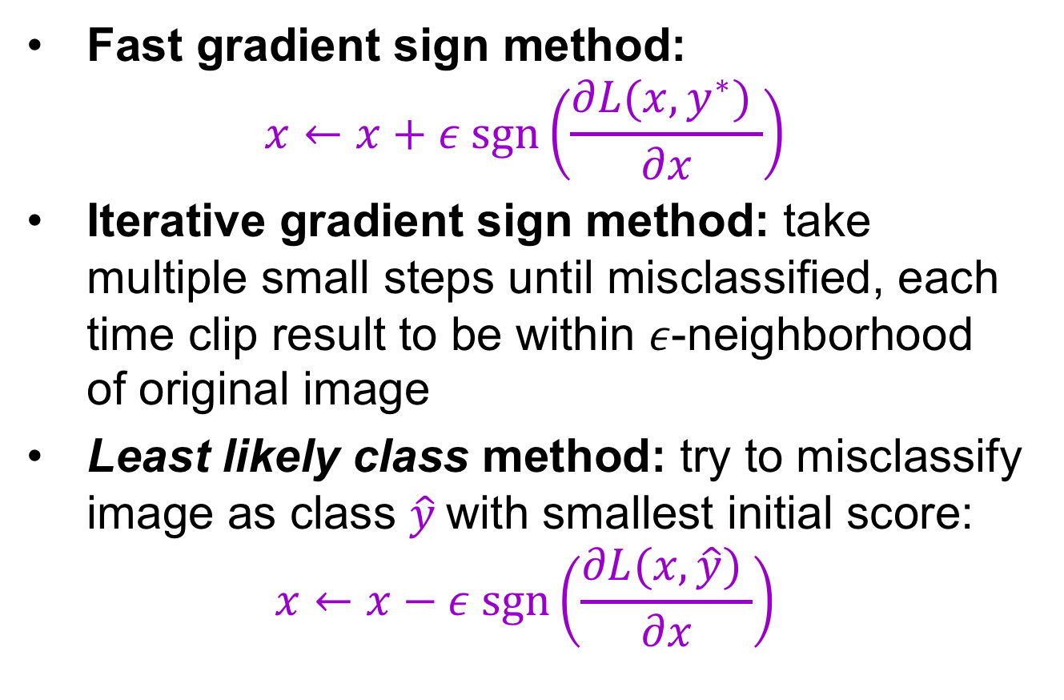
Generating adversarial examples
Fast gradient sign method:
$$x←x+ε sgn⁡\left(\frac{∂L(x,y^{∗}) }{∂x}\right)$$
Iterative gradient sign method: take multiple small steps until misclassified, each time clip result to be within $ε$-neighborhood of original image
Least likely class method: try to misclassify image as class $\hat{y}$with smallest initial score:
$$x←x−ε sgn⁡\left(\frac{∂L(x,\hat{y}) }{∂x}\right)$$
A. Kurakin, I. Goodfellow, S. Bengio, Adversarial examples in the real world, ICLR 2017 workshop

Slide 22
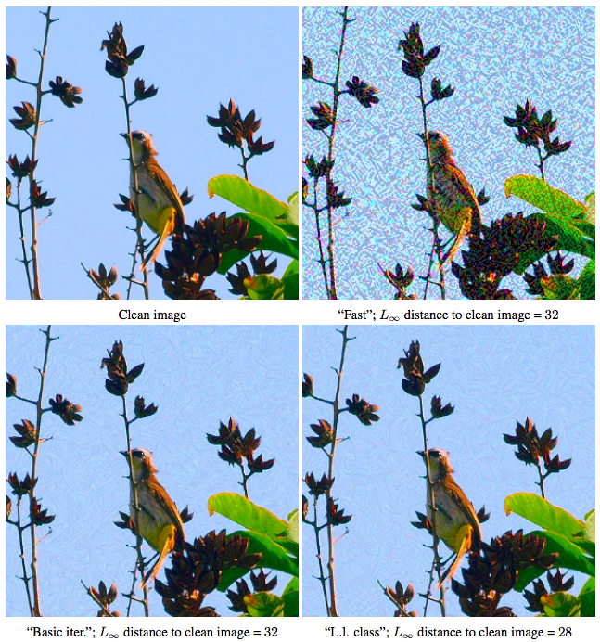
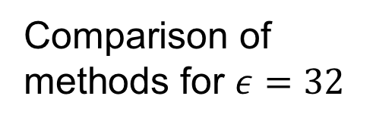
Generating adversarial examples
Comparison of methods for $ε=32$
A. Kurakin, I. Goodfellow, S. Bengio, Adversarial examples in the real world, ICLR 2017 workshop

Slide 23
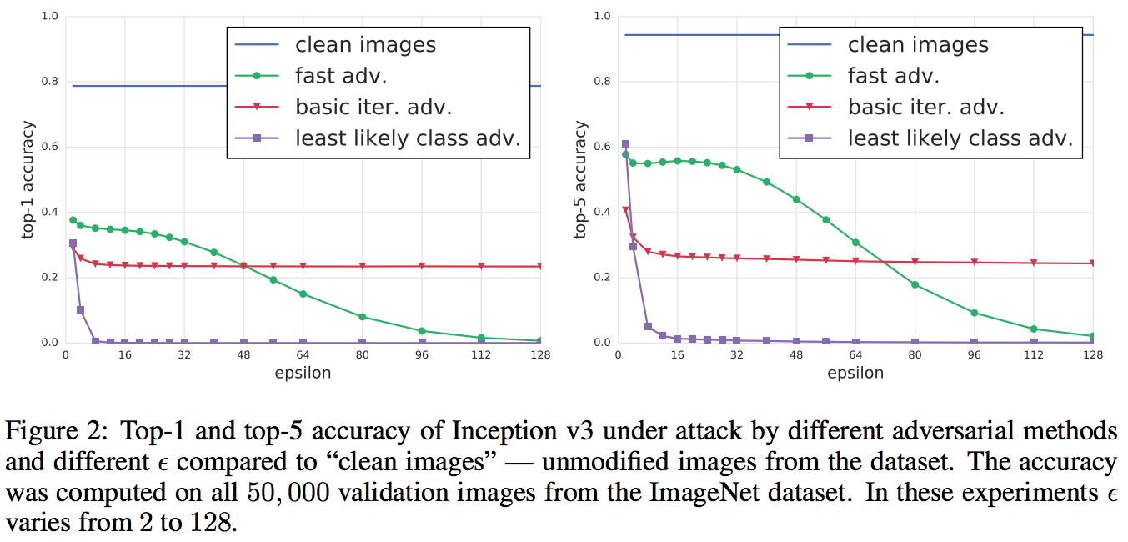
Generating adversarial examples
A. Kurakin, I. Goodfellow, S. Bengio, Adversarial examples in the real world, ICLR 2017 workshop

Slide 24
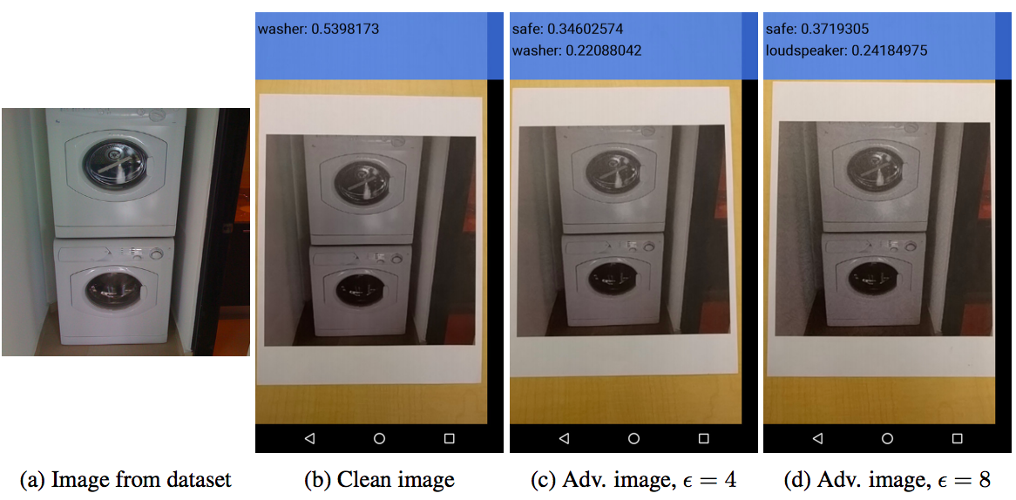
Printed adversarial examples
“Black box” attack on a cell phone app:
A. Kurakin, I. Goodfellow, S. Bengio, Adversarial examples in the real world, ICLR 2017 workshop

Slide 25
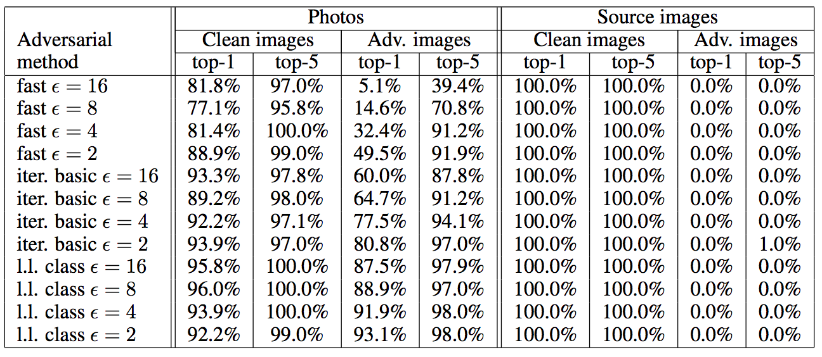
Printed adversarial examples
Accuracies for printed vs. digital images:
A. Kurakin, I. Goodfellow, S. Bengio, Adversarial examples in the real world, ICLR 2017 workshop

Slide 26
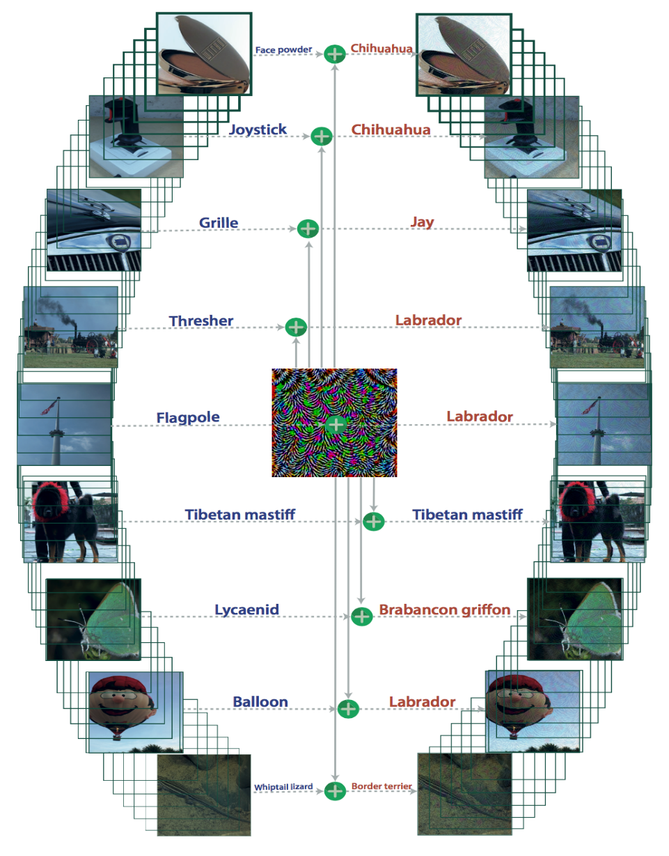
Universal adversarial perturbations
Goal: for a given network, find an image-independent perturbation vector that causes all images to be misclassified with high probability
S.-M. Moosavi-Dezfooli, A. Fawzi, O. Fawzi, P. Frossard, Universal adversarial perturbations, CVPR 2017

Slide 27
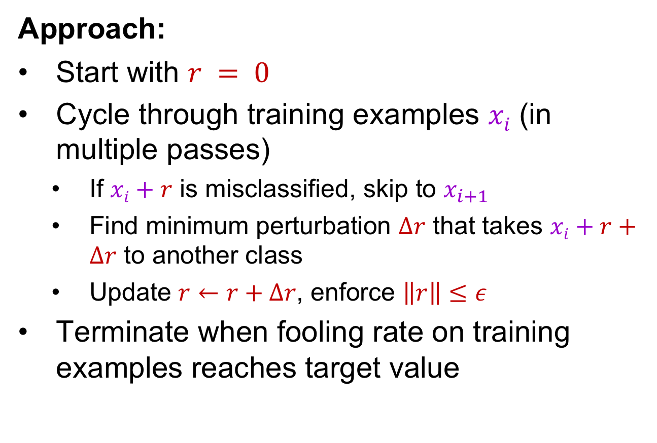
Universal adversarial perturbations
Approach:
Start with $r = 0$
Cycle through training examples $xi$ (in multiple passes)
If $xi+r$ is misclassified, skip to $x_{i+1}$
Find minimum perturbation $Δr$ that takes $xi+r+Δr$ to another class
Update $r←r+Δr$, enforce $\left\|r\right\|≤ε$
Terminate when fooling rate on training examples reaches target value
S.-M. Moosavi-Dezfooli, A. Fawzi, O. Fawzi, P. Frossard, Universal adversarial perturbations, CVPR 2017

Slide 28
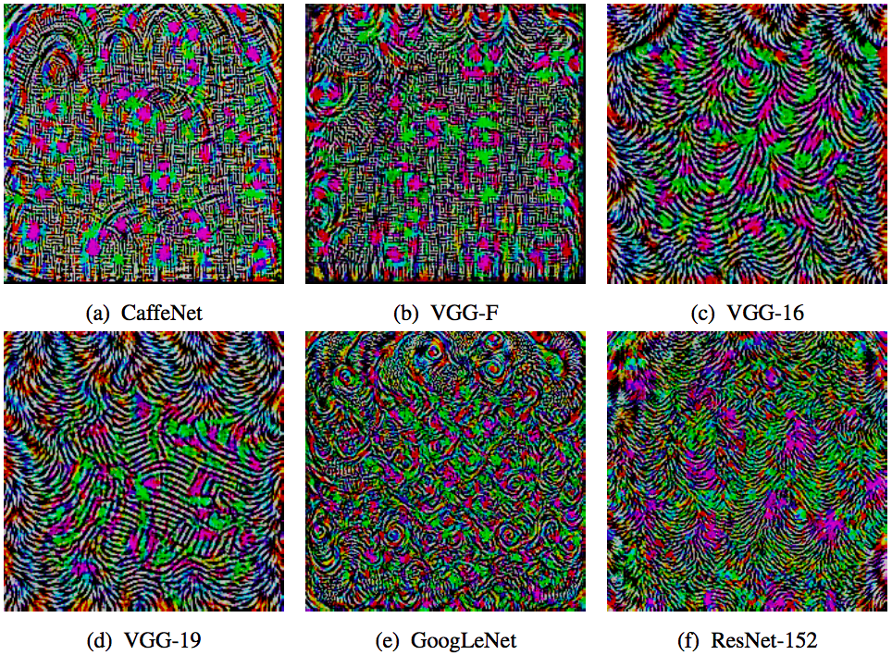
Universal adversarial perturbations
Perturbation vectors computed from different architectures:
S.-M. Moosavi-Dezfooli, A. Fawzi, O. Fawzi, P. Frossard, Universal adversarial perturbations, CVPR 2017

Slide 29
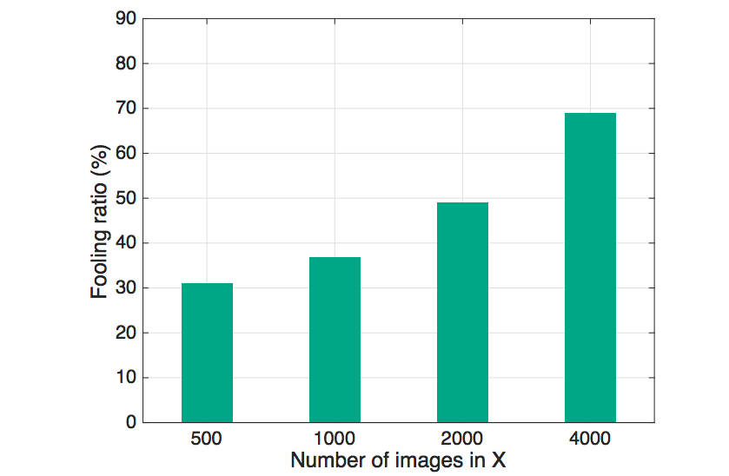
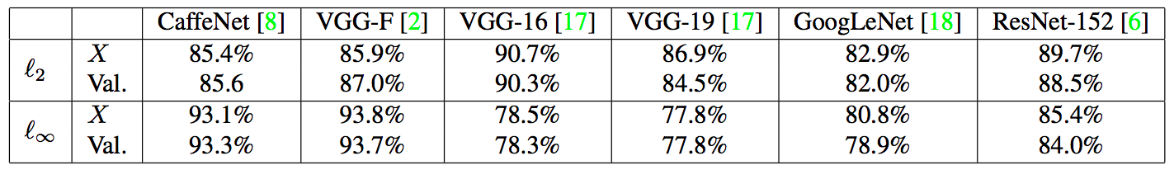
Universal adversarial perturbations
Fooling ratio on validation set vs. training set size for GoogLeNet
Fooling rates on different models after training on 10,000 images
S.-M. Moosavi-Dezfooli, A. Fawzi, O. Fawzi, P. Frossard, Universal adversarial perturbations, CVPR 2017

Slide 30
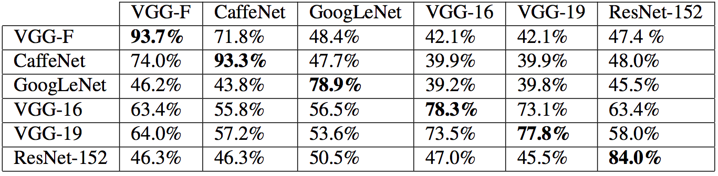
Universal adversarial perturbations
Universal perturbations turn out to generalize well across models!
Fooling rate when computing a perturbation for one model (rows) and testing it on others (columns)
S.-M. Moosavi-Dezfooli, A. Fawzi, O. Fawzi, P. Frossard, Universal adversarial perturbations, CVPR 2017

Slide 31
Black-box adversarial examples
Suppose the adversary can only query a target network with chosen inputs and observe the outputs
Key idea: learn substitute for target network using synthetic input data, use substitute network to craft adversarial examples
Successfully attacked third-party APIs from MetaMind, Amazon, and Google, but only on low-res digit and street sign images
N. Papernot, P. McDaniel, I. Goodfellow, S. Jha, Z. B. Celik, A. Swami, Practical Black-Box Attacks against Machine Learning, ACM Asia Conference on Computer and Communications Security, 2017

Slide 32
Properties of adversarial examples
For any input image, it is usually easy to generate a very similar image that gets misclassified by the same network
To obtain an adversarial example, one does not need to do precise gradient ascent
Adversarial images can (sometimes) survive transformations like being printed and photographed
It is possible to attack many images with the same perturbation
Adversarial examples that can fool one network have a high chance of fooling a network with different parameters and even architecture

Slide 33
Why are deep networks easy to fool?
Networks are “too linear”: it is easy to manipulate output in a predictable way given the input
The input dimensionality is high, so one can get a large change in the output by changing individual inputs by small amounts
Neural networks can fit anything, but nothing prevents them from behaving erratically between training samples
Counter-intuitively, a network can both generalize well on natural images and be susceptible to adversarial examples
Adversarial examples generalize well because different models learn similar functions when trained to perform the same task?

Slide 34
Defending against adversarial examples

Slide 35
Defending against adversarial examples
Adversarial training: networks can be made somewhat resistant by augmenting or regularizing training with adversarial examples
I. Goodfellow, J. Schlens, C. Szegedy, Explaining and harnessing adversarial examples, ICLR 2015
F. Tramer, A. Kurakin, N. Papernot, D. Boneh, P. McDaniel, Ensemble adversarial training: Attacks and defenses, ICLR 2018

Slide 36
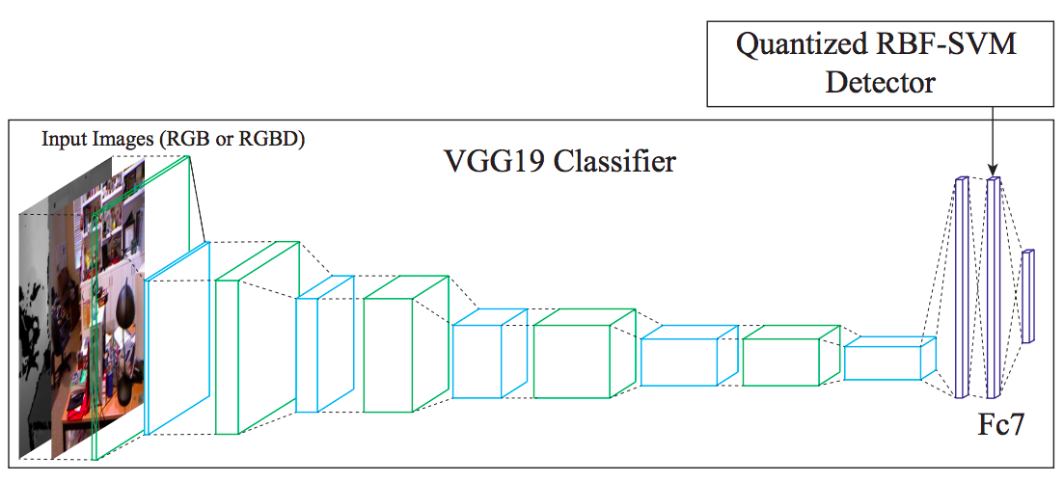
Defending against adversarial examples
Train a separate model to reject adversarial examples: SafetyNet
J. Lu, T. Issaranon, D. Forsyth, SafetyNet: Detecting and Rejecting Adversarial Examples Robustly, CVPR 2017

Slide 37
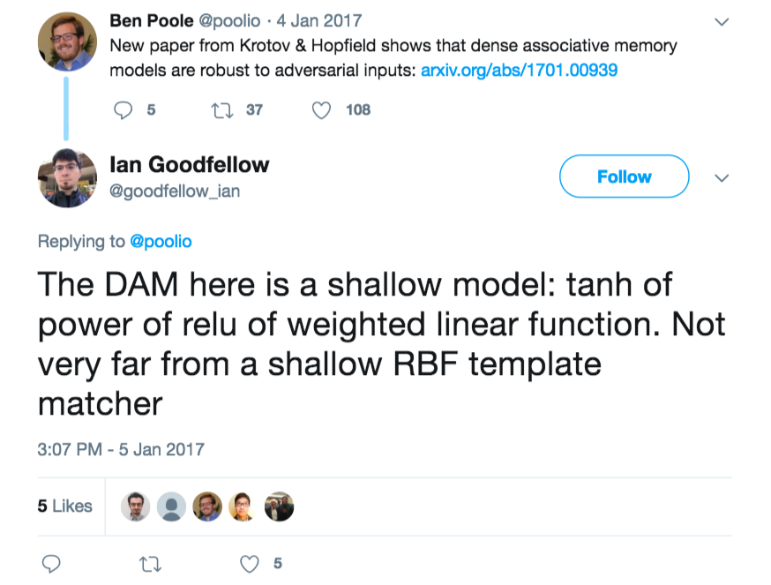
Defending against adversarial examples
Design highly nonlinear architectures robust to adversarial perturbations
D. Krotov, J. Hopfield, Dense Associative Memory is Robust to Adversarial Inputs, arXiv 2017

Slide 38
Adversarial examples: Summary

Slide 39
Adversarial examples: Summary
Generating adversarial examples
Finding smallest “fooling” transformation
Gradient ascent
Fast gradient sign, iterative variants
Universal adversarial perturbations
Generalizability of adversarial examples
Why are neural networks easy to fool?
Defending against adversarial examples
Adversarial training
Learning to reject adversarial examples
Robust architectures
Image pre-processing

Slide 40
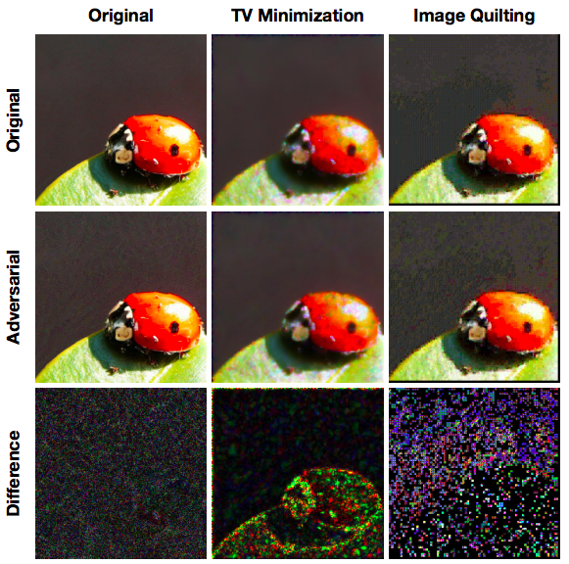
Defending against adversarial examples
Pre-process input images to disrupt adversarial perturbations
C. Guo, M. Rana, M. Cisse, L. van der Maaten, Countering Adversarial Images Using Input Transformations, ICLR 2018

Slide 41
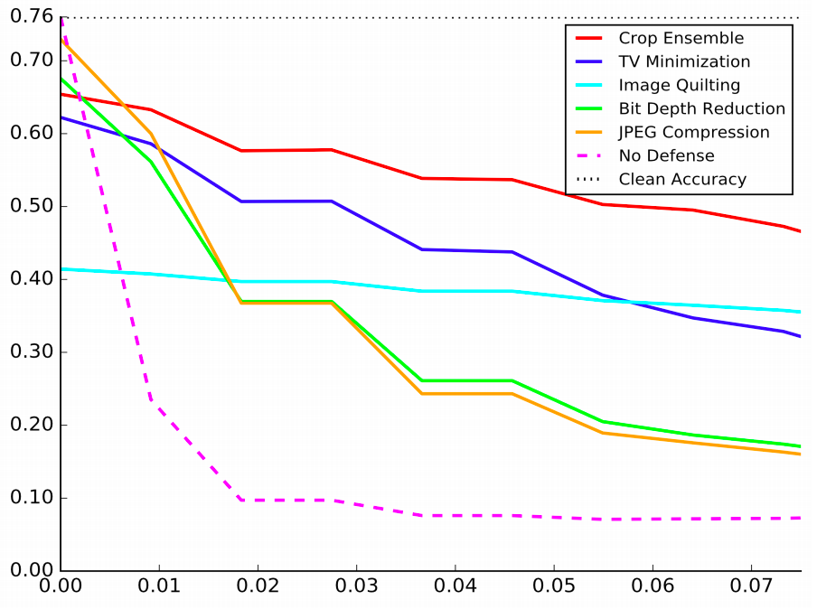
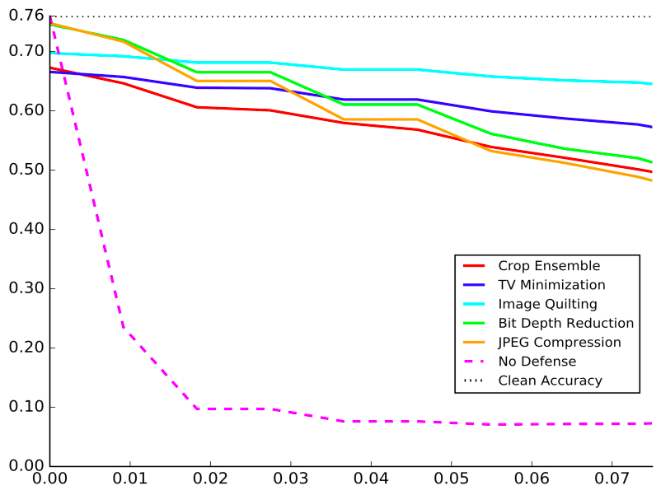

Defending against adversarial examples
Pre-process input images to disrupt adversarial perturbations
ResNet-50 tested on transformed images
ResNet-50 trained and tested on transformed images
Top-1 Accuracy
Strength of FGSM transformation
C. Guo, M. Rana, M. Cisse, L. van der Maaten, Countering Adversarial Images Using Input Transformations, ICLR 2018
Notes:
From the paper: In particular, ensembling 30 predictions over different, random image crops is very efficient: these predictions are correct for 40−60% of the images (note that 76% is the highest accuracy that one can expect to achieve). This result suggests that adversarial examples are susceptible to changes in the location and scale of the adversarial perturbations.

Slide 42
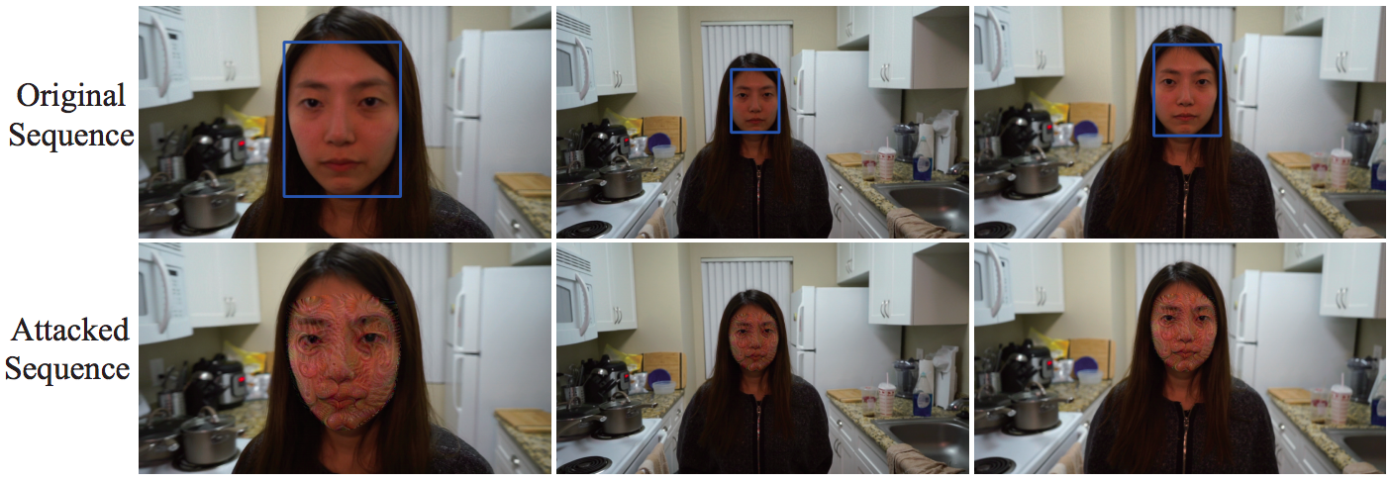
Adversarial examples for detection
TL;DR: It is much harder to fool a detector like Faster R-CNN or YOLO than a classifier; large perturbations are currently required
J. Lu, H. Sibai, E. Fabry, Adversarial examples that fool detectors, arXiv 2018

Slide 43
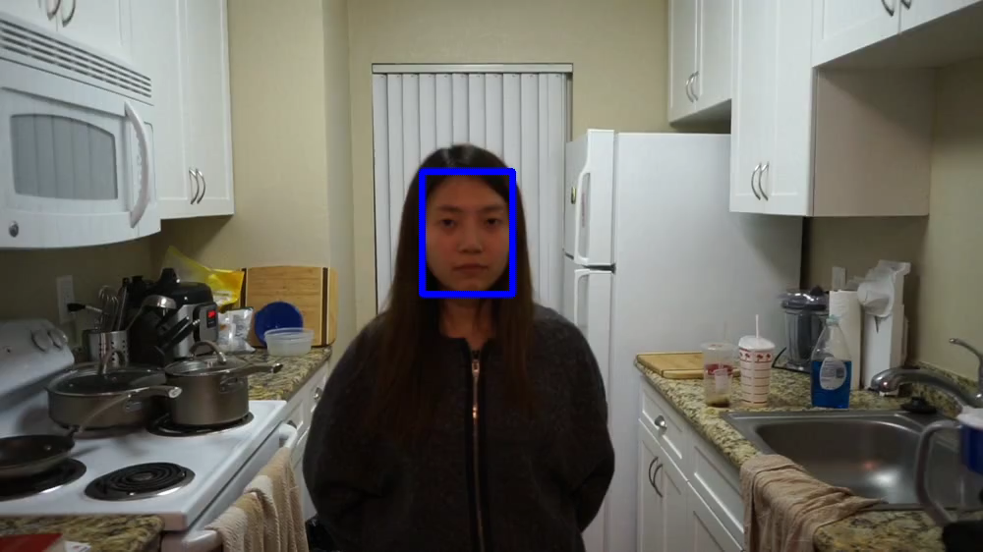
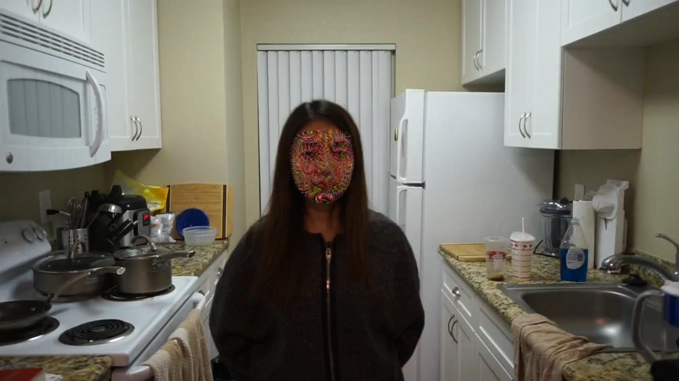
Adversarial examples for detection
TL;DR: It is much harder to fool a detector like Faster R-CNN or YOLO than a classifier; large perturbations are currently required
Original w/ Faster R-CNN detections
Attacked
J. Lu, H. Sibai, E. Fabry, Adversarial examples that fool detectors, arXiv 2018

Slide 44
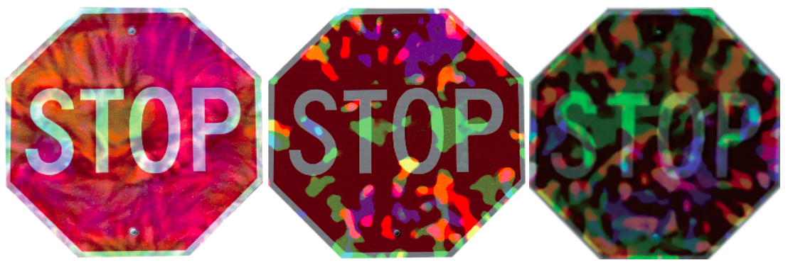
Adversarial examples for detection
TL;DR: It is much harder to fool a detector like Faster R-CNN or YOLO than a classifier; large perturbations are currently required
It is even harder to fool a detector with physical objects
”All three patterns reliably fool detectors when mapped into videos. However, physical instances of these patterns are not equally successful. The first two stop signs, as physical objects, only occasionally fool Faster RCNN; the third one, which has a much more extreme pattern, is more effective.”
J. Lu, H. Sibai, E. Fabry, Adversarial examples that fool detectors, arXiv 2018

Slide 45
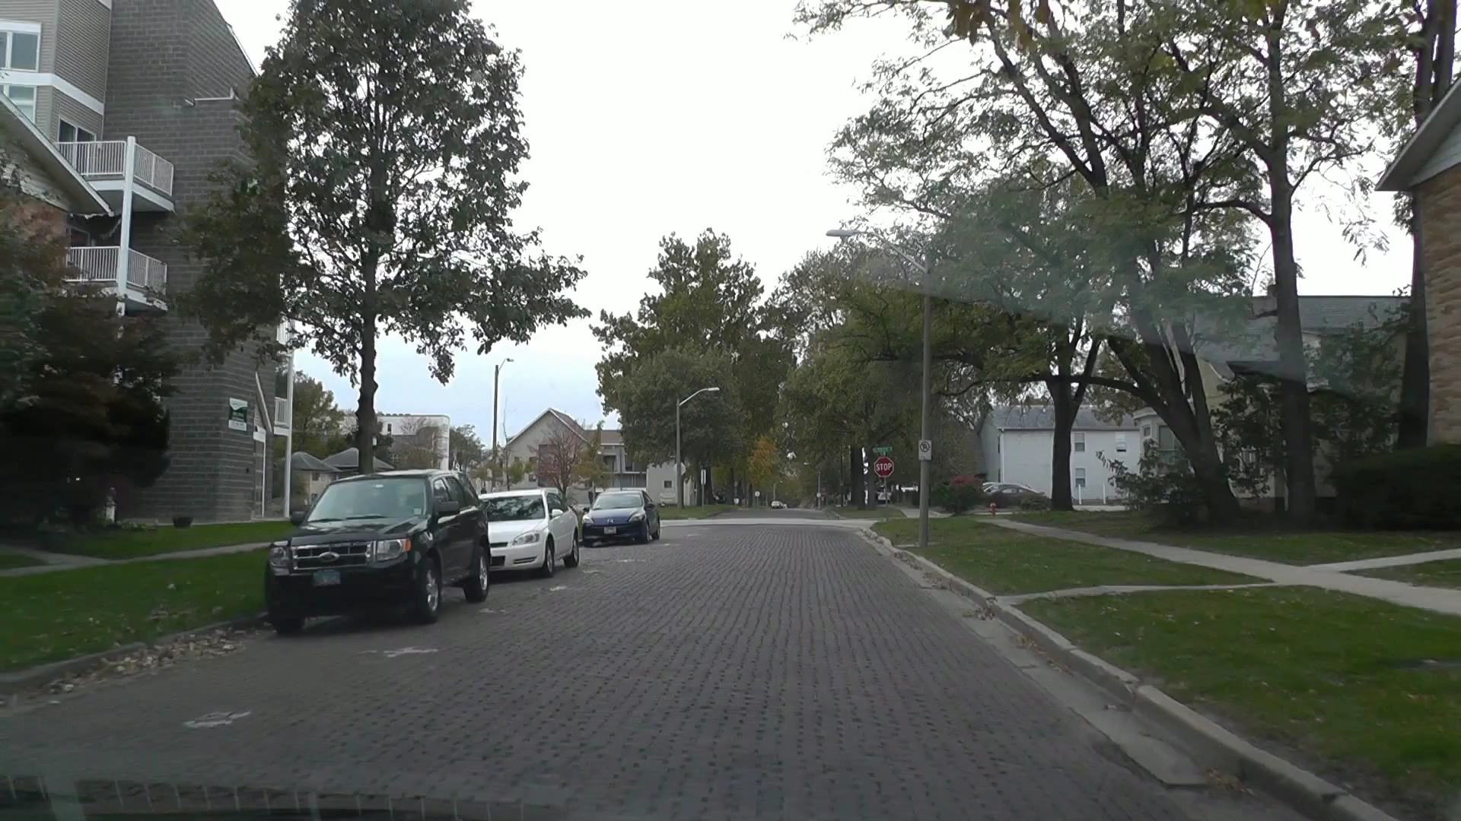
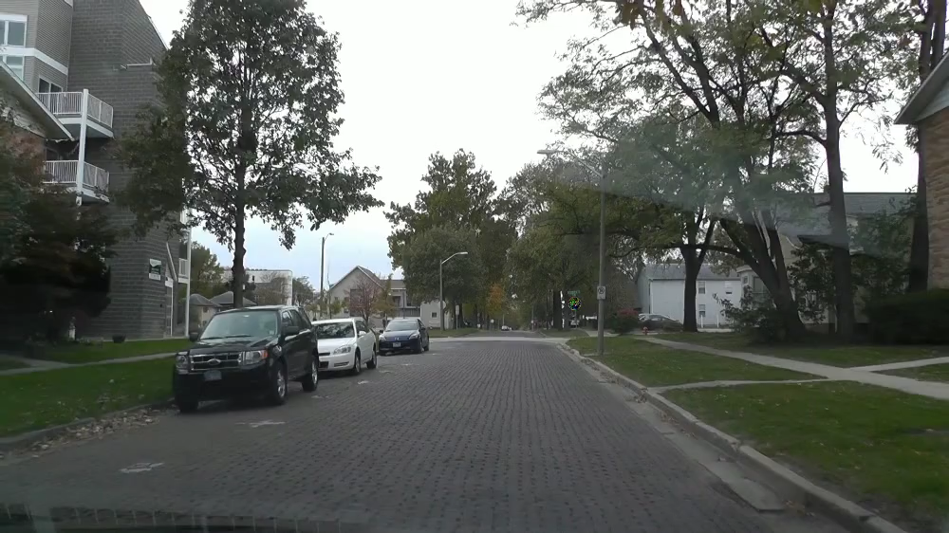
Adversarial examples for detection
TL;DR: It is much harder to fool a detector like Faster R-CNN or YOLO than a classifier; large perturbations are currently required
It is even harder to fool a detector with physical objects
Original w/ Faster R-CNN detections
Digitally attacked
J. Lu, H. Sibai, E. Fabry, Adversarial examples that fool detectors, arXiv 2018

Slide 46
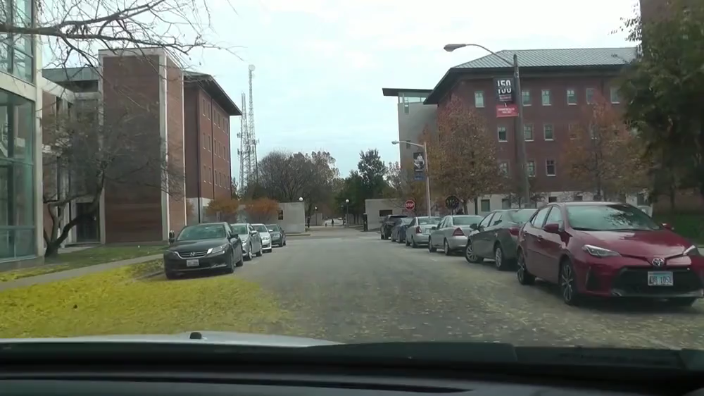
Adversarial examples for detection
TL;DR: It is much harder to fool a detector like Faster R-CNN or YOLO than a classifier; large perturbations are currently required
It is even harder to fool a detector with physical objects
Physical adversarial stop sign
J. Lu, H. Sibai, E. Fabry, Adversarial examples that fool detectors, arXiv 2018

Slide 47
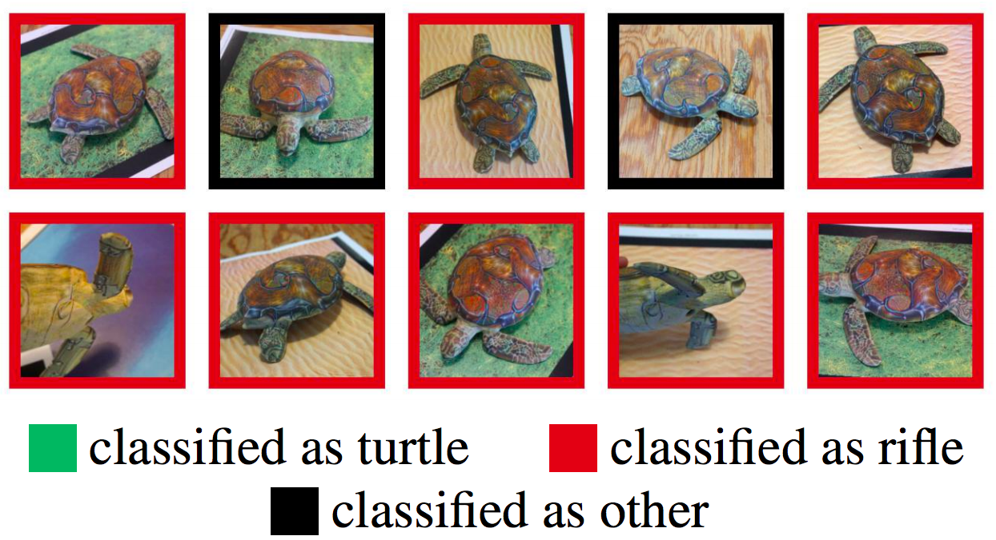
Robust adversarial examples
3D printed adversarial object (YouTube video)
A. Athalye, L. Engstrom, A. Ilyas, K. Kwok, Synthesizing Robust Adversarial Examples, arXiv 2018
https://blog.openai.com/robust-adversarial-inputs/

Slide 48
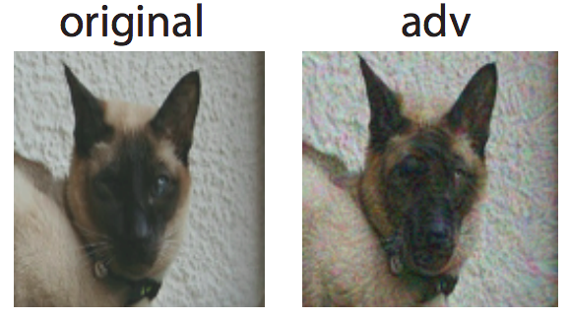
Adversarial examples and humans
Adversarial examples that are designed to transfer across multiple architectures can also be shown to confuse the human visual system in rapid presentation settings
G. Elsayed et al., Adversarial Examples that Fool both Computer Vision and Time-Limited Humans, arXiv 2018

Slide 49
Adversarial examples: Summary
Generating adversarial examples
Finding smallest “fooling” transformation
Gradient ascent
Fast gradient sign, iterative variants
Universal adversarial perturbations
Generalizability of adversarial examples
Why are neural networks easy to fool?
Defending against adversarial examples
Adversarial training
Learning to reject adversarial examples
Robust architectures
Image pre-processing

